Slide 1

Software requirements (swr302)
Specifying data requirements
(chapter 13)

Slide 2
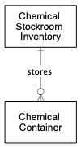
Modeling data relationships
Purpose: understand and communicate the data components of the business or the system, without implying that the product will necessarily even include a DB
How to build ERD (remind) and class diagram?

Slide 3
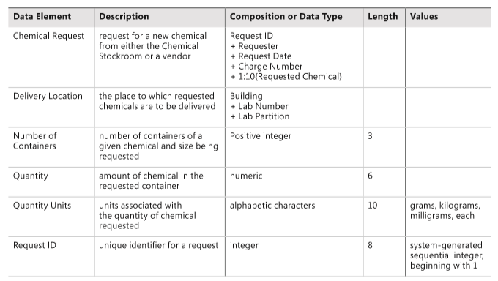
The data dictionary
Collection of detailed information about the data entities used in an application

Slide 4
Data analysis 1/2
When performing data analysis, you can map various information representations against one another to find gaps, errors, and inconsistencies.
The entities in your entity-relationship diagram are likely defined in the data dictionary.
The data flows and stores in your DFD are probably found somewhere in your ERD, as well as in the data dictionary.
The display fields found in a report specification also should appear in the data dictionary.
During data analysis, you can compare these complementary views to identify errors and further refine your data requirements.

Slide 5
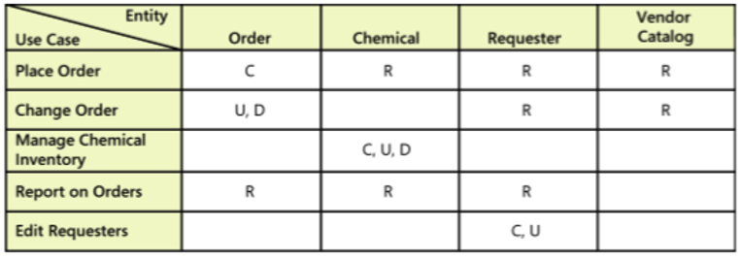
Data analysis 2/2
A CRUD (Create, Read, Update, and Delete) matrix is a rigorous data analysis technique for detecting missing requirements.
A CRUD matrix correlates system actions with data entities to show where and how each significant data entity is created, read, updated, and deleted.
Notes:
Rigorous: nghiêm ngặt

Slide 6
Specifying reports 1/2
Many applications generate reports from one or more databases, files, or other information sources.
Reports can consist of traditional tabular presentations of rows and columns of data, charts and graphs of all types, or any combination
Exploring the content and format of the reports needed is an important aspect of requirements development

Slide 7
Specifying reports 2/2
Eliciting reporting requirements
Report specification considerations
Consider other variations
Find the data
Anticipate growth
Look for similarities
Distinguish static and dynamic reports
Prototype reports
A report specification template: page 255

Slide 8
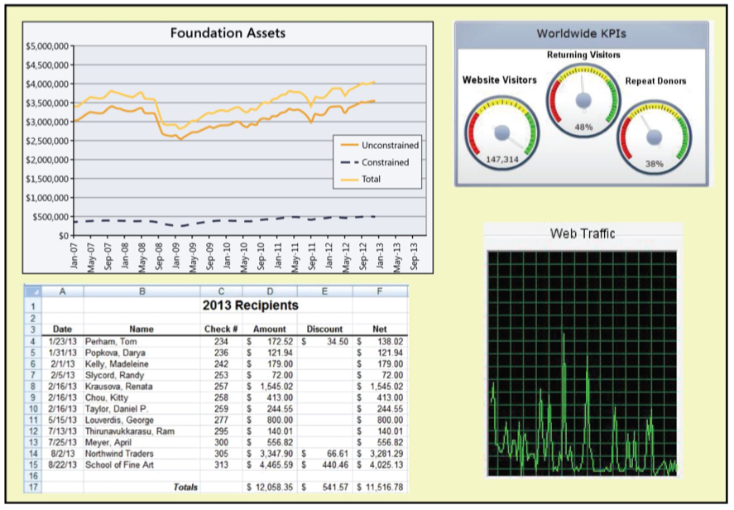
Dashboard reporting 1/2

Slide 9
Dashboard reporting 2/2
A dashboard is a screen display or printed report that uses multiple textual and/or graphical representations of data to provide a consolidated, multidimensional view of what is going on in an organization or a process
Purpose
pull together information about sales, expenses, key performance indicators (KPIs), and the like.
Stock trading applications display a bewildering (to the novice) array of charts and data that the skilled eye can scan and process at a glance
Notes:
Bewildering: hoang mang
Novice: người mới

Slide 10


